Slide 1
OSTEOPOROSIS
Dr.Nisha
Assistant professor
Dept:of practice of medicine

Slide 2
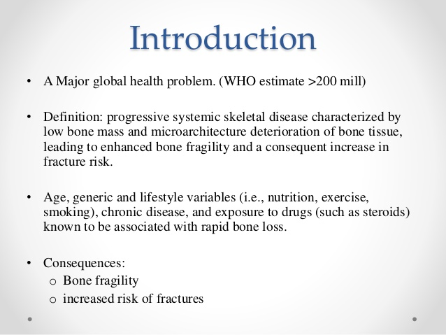

Slide 3
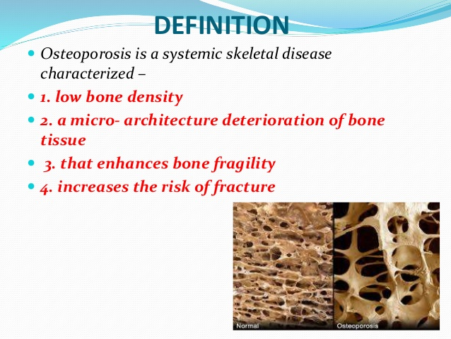

Slide 4
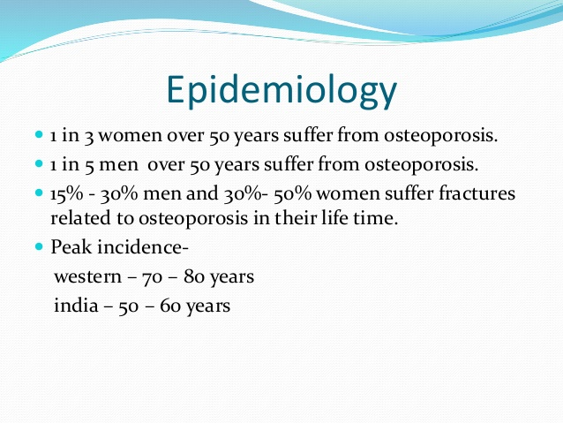

Slide 5
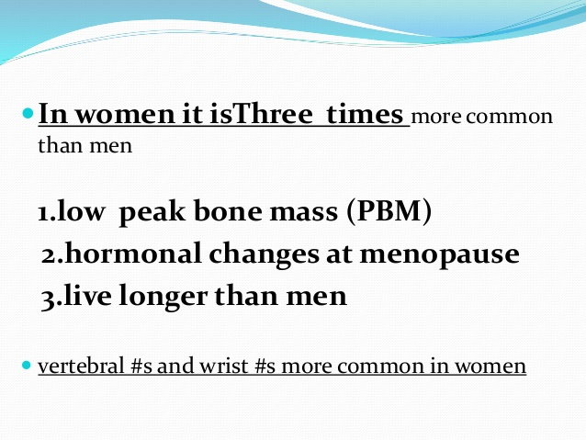

Slide 6
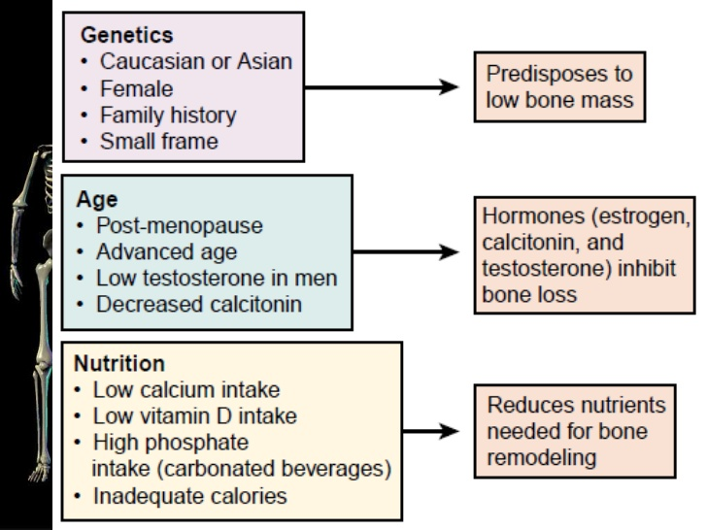

Slide 7
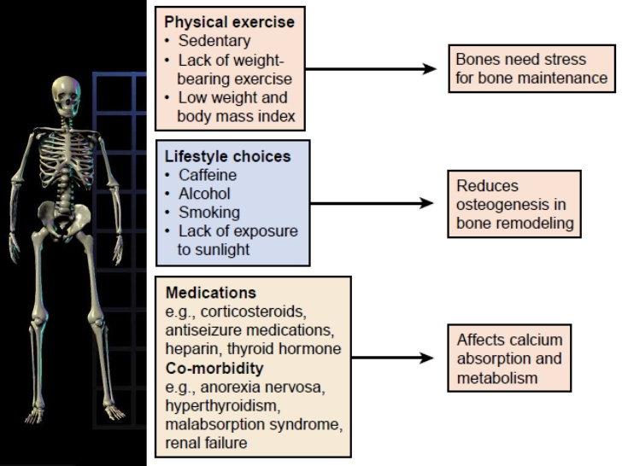

Slide 8
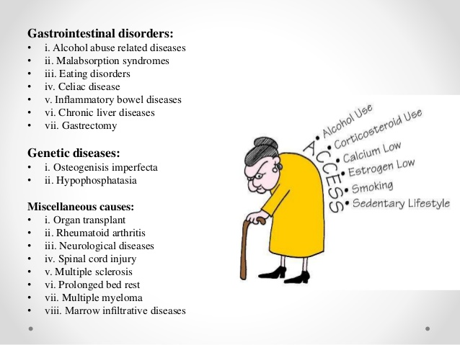

Slide 9
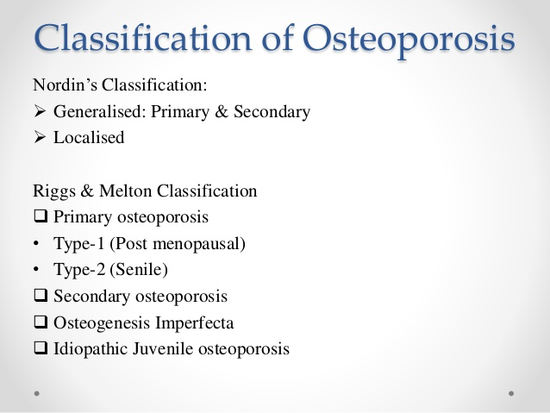

Slide 10
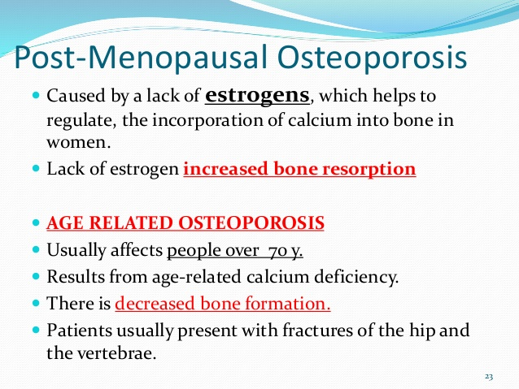

Slide 11
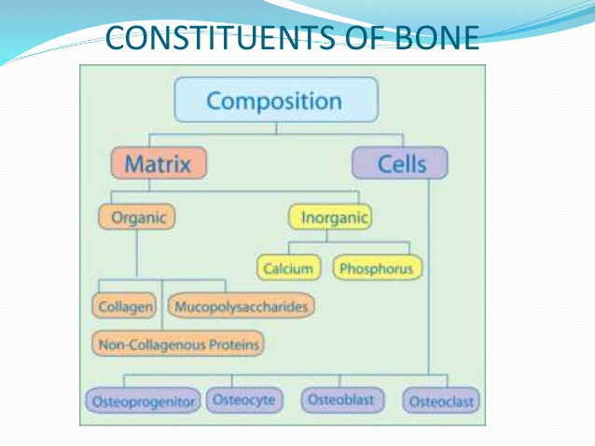

Slide 12
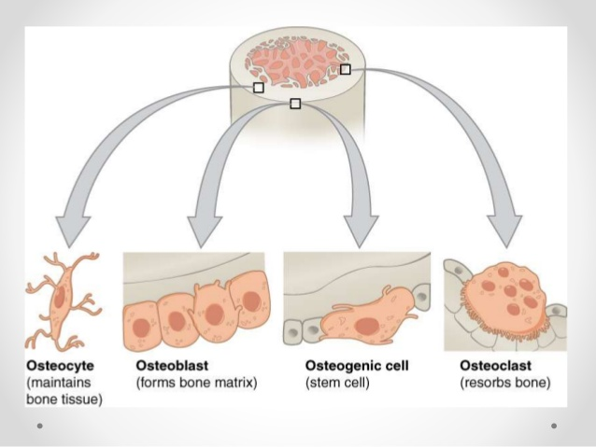

Slide 13
CAUSES:
The strength of the bones depends on their size and density; Bone density depends in part on the amount of calcium, phosphorus and other minerals the bones contain.
When the bones contain fewer minerals than normal, they are less strong and eventually loose their internal supporting structure.

Slide 14
THE PROCESS OF BONE REMODELLING
Bone is continuously changing – new bone is made and old bone is broken down-process called remodelling or bone turn over.
A full cycle of bone remodelling takes about 2-3months.
In young-the body makes new bone faster than it breaks down old bone and the bone mass increases. Reaches the peak bone mass in mid 30,s

Slide 15
After that bone remodelling continues, but loses slightly more than gain.
At menopause, when estrogen levels drop, bone loss increases dramatically.
Many factors contribute to bone loss, the leading cause in women is decreased estrogen production during menopause.

Slide 16
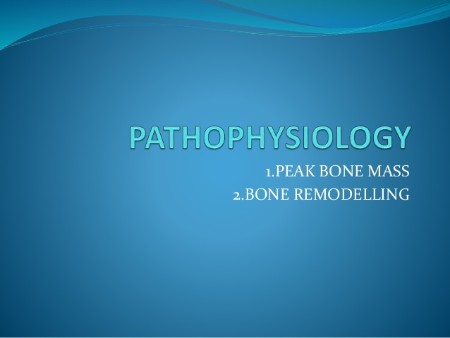

Slide 17
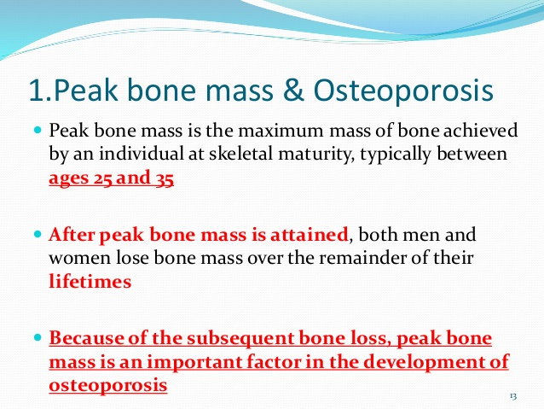

Slide 18
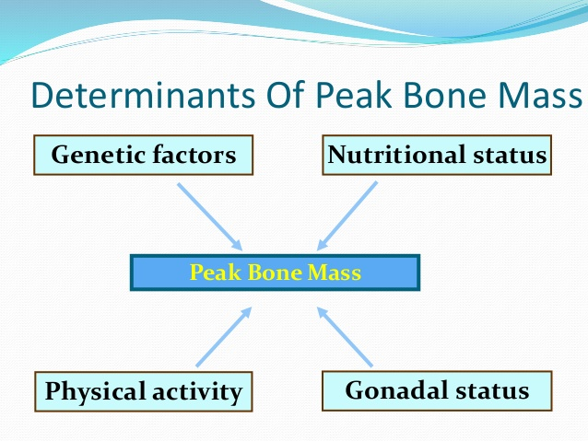

Slide 19
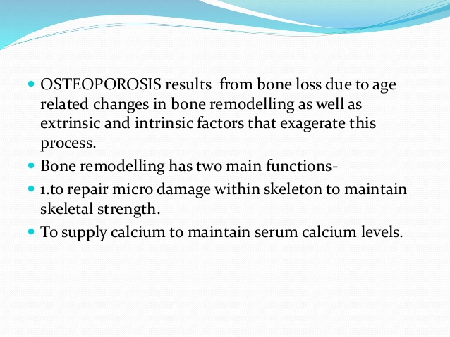

Slide 20
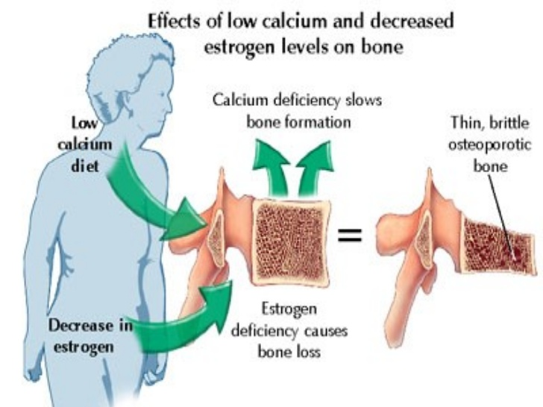

Slide 21
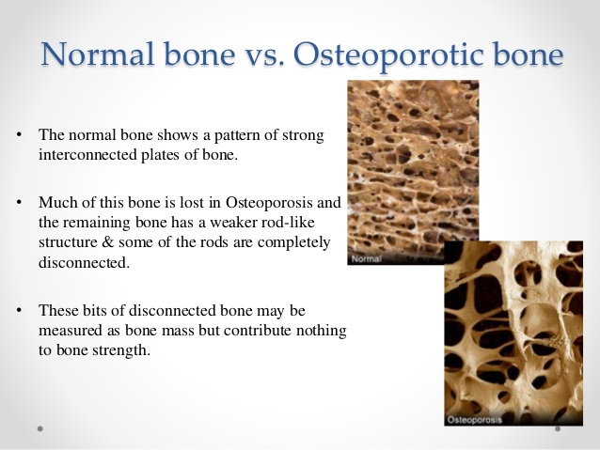

Slide 22
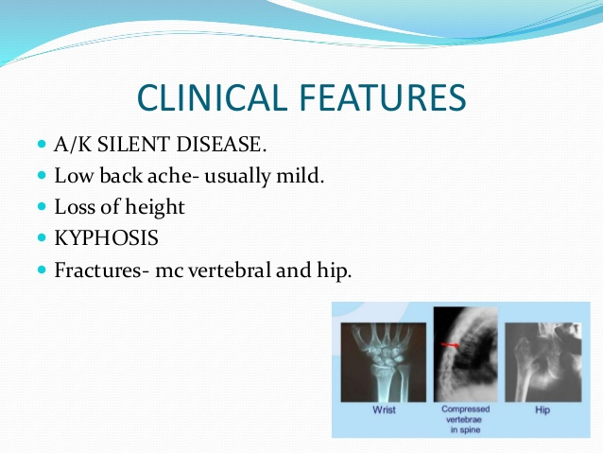

Slide 23
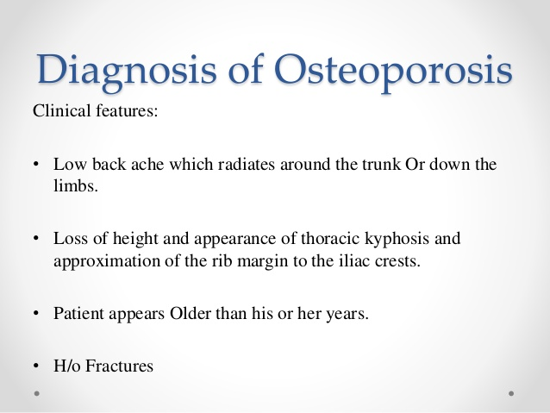

Slide 24
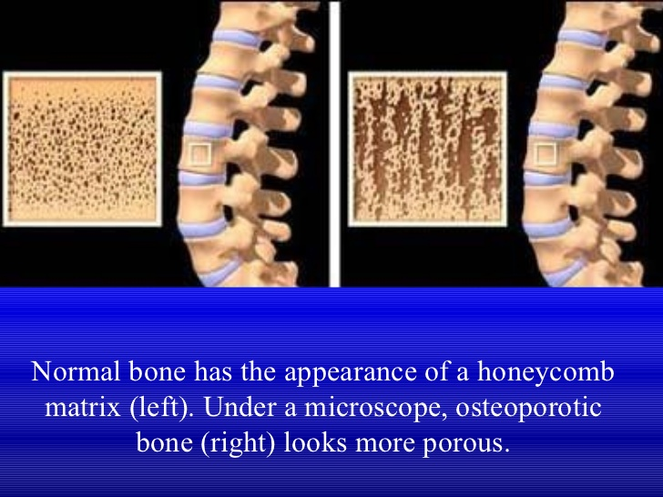

Slide 25
